Slide 1
COSMOS Cultivate Resilient Smart Objects for Sustainable City Applications
COSMOS Main Tangible Outcome
Achilleas Marinakis (ICCS/NTUA)

Slide 2
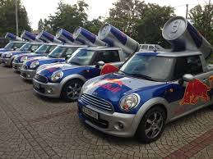
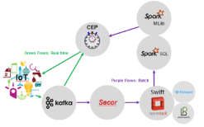
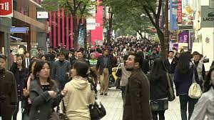
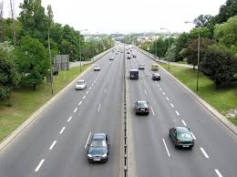
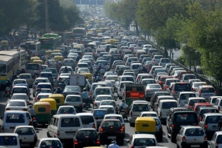
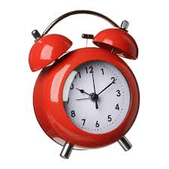
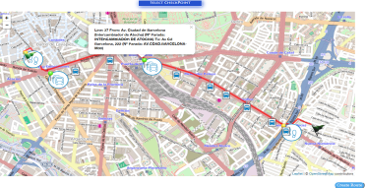
Concept of Awareness on top of awareness (events on top of events)

Slide 3
Exploited through a marketplace structure
The concept focuses around an Events Marketplace, which is a brokering entity between publishers and subscribers of Events
Publishers forward their generated events information, get paid and rated by subscribers
Subscribers enroll for receiving the events, pay publishers
A subscriber may receive an event, combine it with another piece of information/event and produce new events, that are then themselves sold through the market place
Types of Events: Events that do not have to do with private data, events created from available public information formulated accordingly, Smart events reasoned through big data analytics approaches
Examples from COSMOS: Madrid Traffic notifications, Large Crowd Concentration from Twitter
Main target group: Application Developers
Early version available!
Eventflows.com

Slide 4
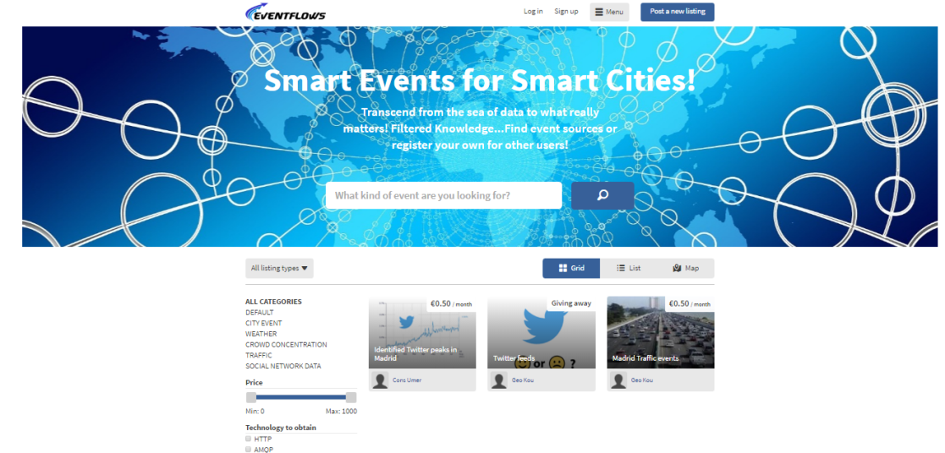
Marketplace Entity
Join as user-producer and register your events notifications or as a user-consumer and check out the existing events!
Not so many, to be populated with COSMOS generated events and outcomes of Workshops in progress
At the moment you can specify your own endpoints for publication
In the following months we will also extend the backend to include the Pub/Sub flow
Tools to assist developers
Publication/Consumption flows
Example flows from existing COSMOS developments at
https://github.com/COSMOSFP7
Bluemix flow to be made available as starting point for big data ingestion and analytics

Slide 5
Thank you! Any questions?
For any questions contact George Kousiouris (
gkousiou@mail.ntua.gr) or
Juan Rico (juan.rico@atos.net)
www.iot-cosmos.eu
The research leading to these results has received funding from the EC Seventh Framework Programme FP7/2007-2011 under Grant Agreement n° 609043

