Slide 1
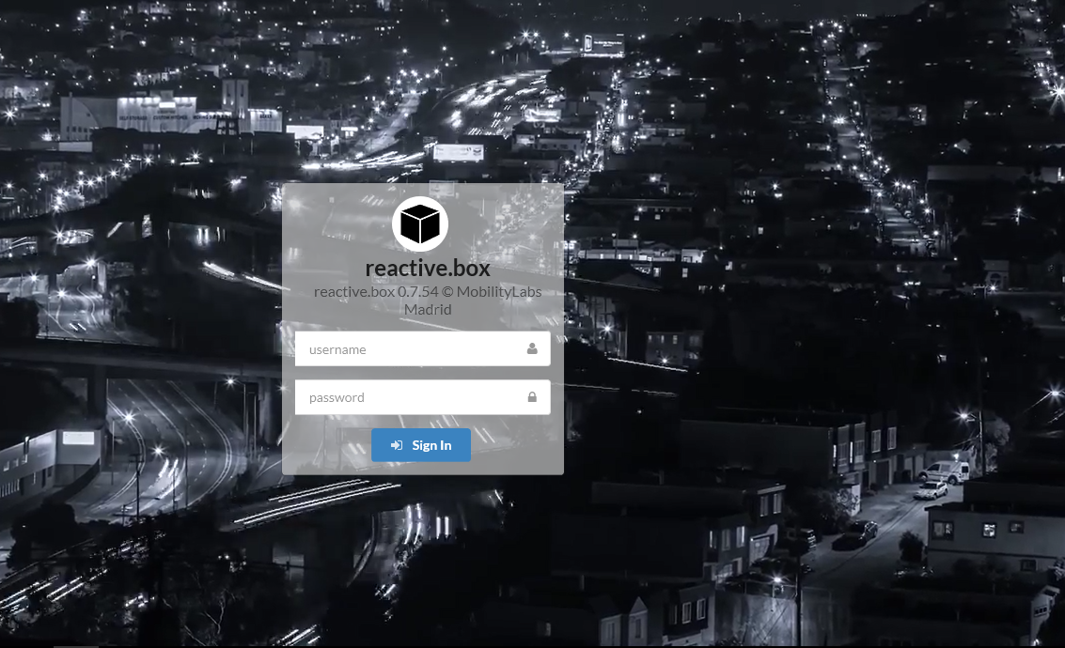
DATA AS AN ASSET: IMPROVED INTEGRATION, MANAGEMENT AND DISSEMINATION
AN OPEN PLATFORM FOR TRANSPORT DATA IN MADRID
Sergio Fernández Balaguer
Empresa Municipal de Transportes de Madrid, S.A.

Slide 2
Notes:
CAPACIDAD TECNOLÓGICA DE EMT
FLOTA, ÚLTIMAS TECNOLOGÍAS DE INFORMACIÓN, COMUNICACIÓN, WIFI, DATOS EN TIEMPO REAL, GPS, TECNOLOGÍA EMBARCADA
In addition to that, the software developed has a compatible protocol that allows the integration of multiple systems with their own management functionalities. This conectables can be either software or hardware

Slide 3
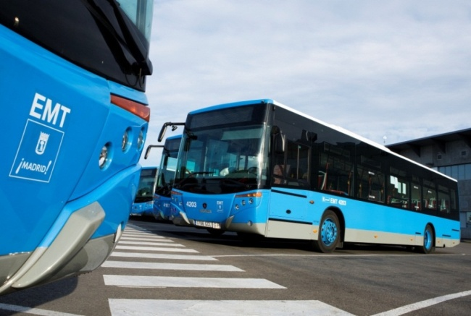
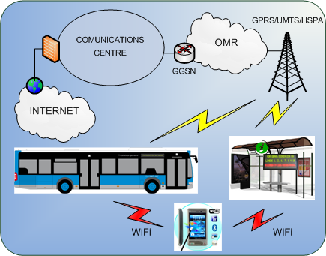
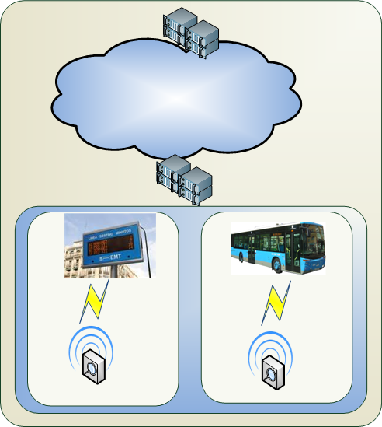
Some figures
1.904 buses
203 bus routes (176 daytime/27 night service),
4,629 bus shelters
800 electronic information panels (PMV)
404 million passengers / year
91 million km / year
Open data policy
On board wifi
ICT/ITS

Slide 4
OPEN PLATFORM FOR OPEN DATA SERVICES
Geographic infrastructure of the transport network
Bus service and incidences information
Multimedia information systems
Open data portal
http://opendata.emtmadrid.es

Slide 5
Cultivate resilient smart Objects for Sustainable city applicatiOnS
http://iot-cosmos.eu/
ICT cloud-based platform and mobility services available, universal and safe for all users
http://www.moveus-project.eu/
An EU / Japan collaboration to deliver Intelligent Knowledge-as-a-Service
http://ikaas.com/

Slide 6
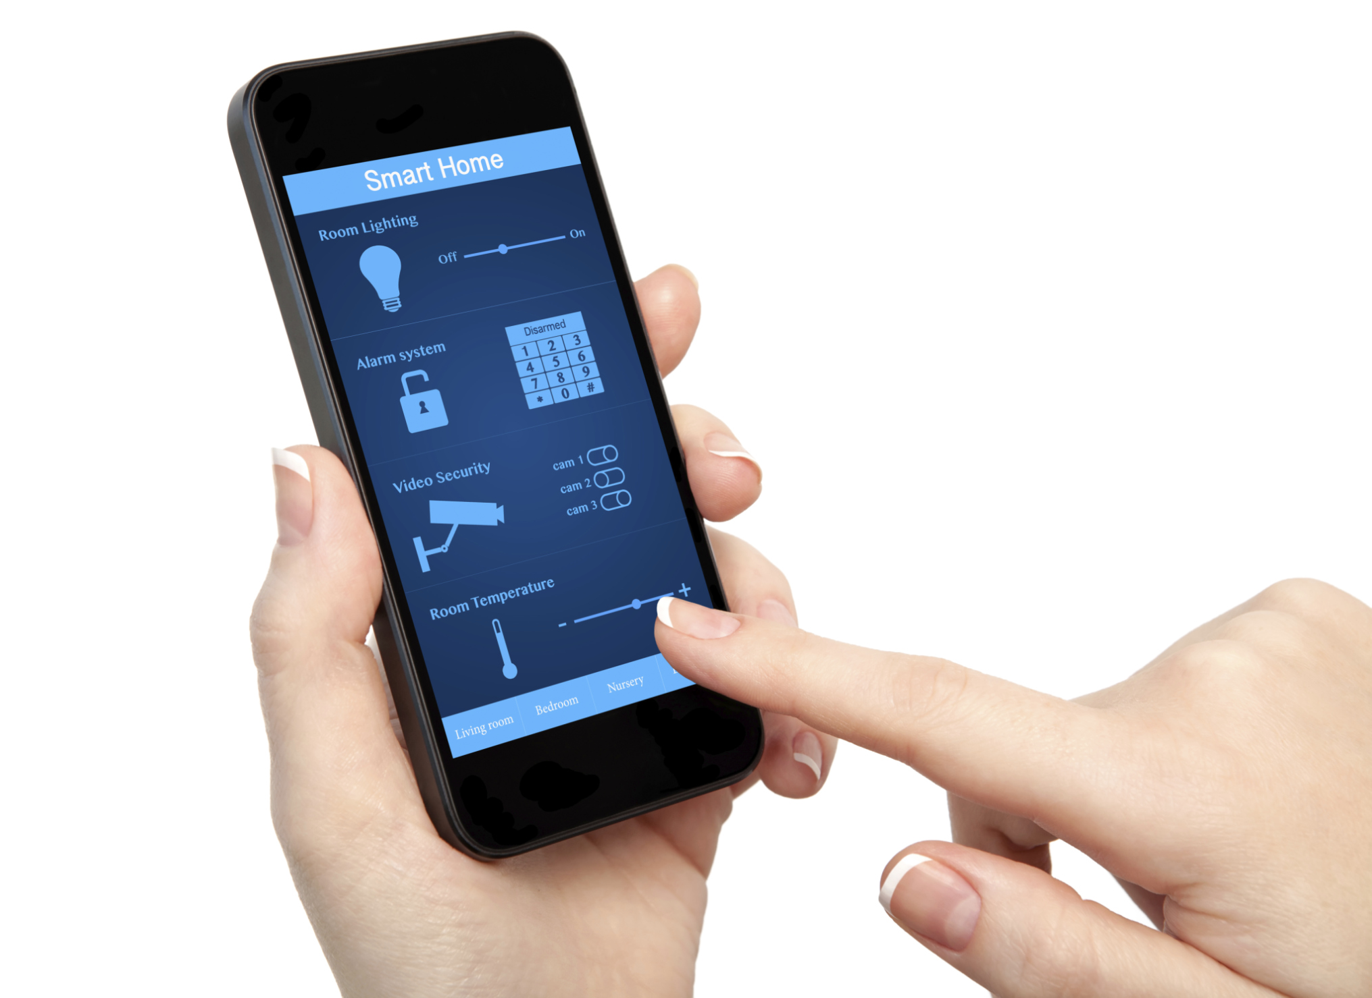
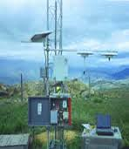
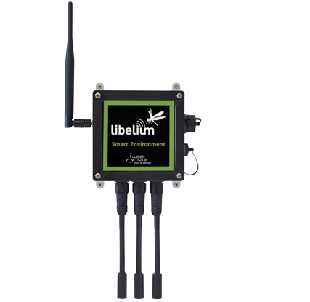
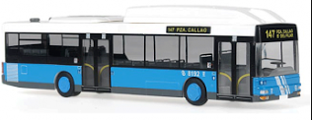
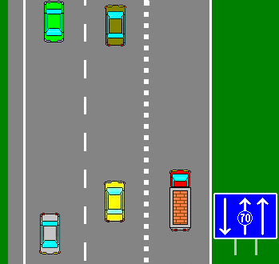
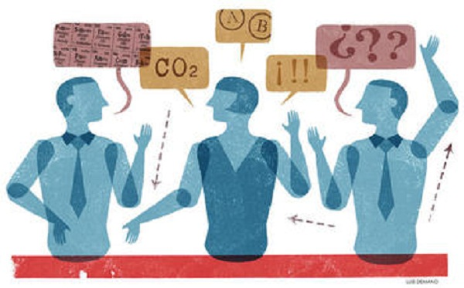
INTERNET
DATA
OBSERVERS/ CONSUMERS
ENVIRONMENT
SENSORS
PUBLIC TRANSPORT
TRAFFIC
An open and event oriented platform has been developed with the aim of providing to the mobility environment of the city of Madrid an exchange system of information in real time.
The platform allows the entry of data from multiple stakeholders (institutions, citizens…), making multiple and unlimited exchanges
TRAFFIC LIGHTS
CITIZENS & COMPANIES

Slide 7
Creating and observing an event
USERS CONTROL
Authorized?
Producer
Observer
AMQP
DDP
The design of the platform, called “rbmobility” is simple. The client, once authenticated, can insert, update or delete data using a queue server.
The information gets to a NOSQL DDBB which is controlled by a Meteor Server.
Any authorized client looking at a certain type of information to which is subscribed will get in real time all changes produced in the different layers it is looking at
CLOUD & INTERNET CORE
Rbmobility.emtmadrid.es
Data Layers

Slide 8
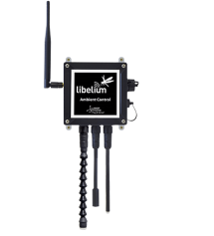
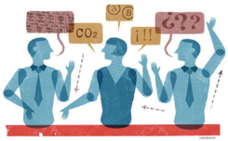
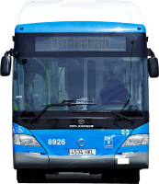
MADRID SENSORS SYSTEM INTEGRATOR
Local
Cloud DB
MADRIDOPENMOBILITYLAB
MYBUS
REACTIVE BOX SERVER
RB layer collections
busEvents
Bigdata collections
buslayers
userlayers
sensorlayers
stoplayers
linelayers
pmvEvents
userEvents
sensorEvents
messagelayers (VEPROT)
alertEvents
trafficlayers
parkinglayers
trafficEvents
The model is soported by a NOSQL DDBB (Mongo DB)
It contains the semantic definition of objects
It has real time data and BigData collections

Slide 9
To set it, a mobility lab for the city has been created (openlabmobility.emtmadrid.es)
Madrid data model design
The madrid entities basic model has been defined based on the following AIM:
SHARED AND OPEN
AdaptabLE
scalabLE
standard
The data model is public and open, and it is published in
https://github.com/madridopenlabmobility/MOBILITY-MADRID-virtual-entities
Notes:
Madrid lab has the aim to become a testing site for any system or application, either public or private, that likes to observe mobility events and generate useful data (intelligent knowledge or services) to others.
It is formed by an internet platform that allows getting conected virtually to a bus and moving aroung with it, and a platform to watch events, the Reactive Box. Its open to anyone and access can be applied by our open data portal.
All information is published in open in Github

Slide 10
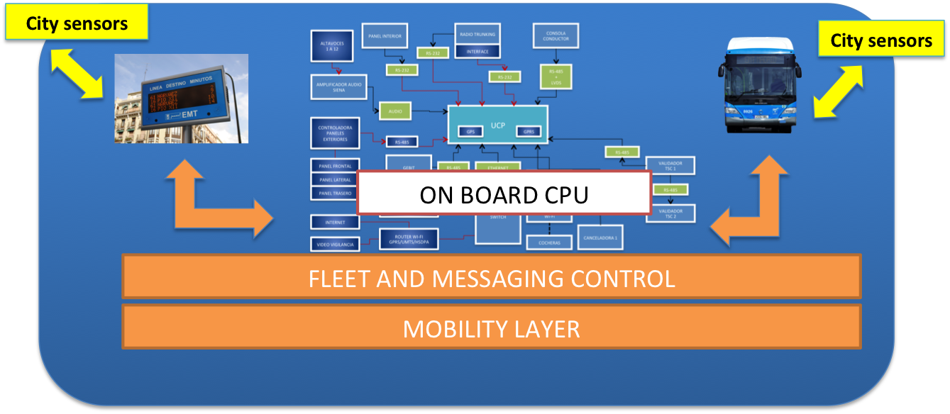
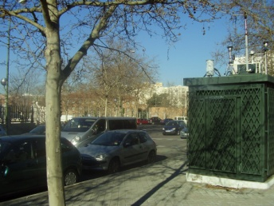
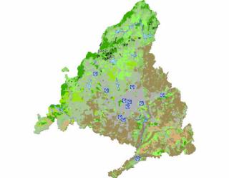
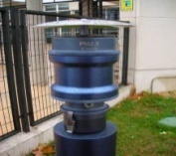
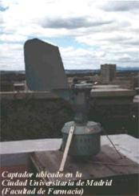
STATIC SENSORS
(MADRID CITY COUNCIL)
DYNAMIC SENSORS (EMT MADRID)
POLLEN SENSORS
(PALINOCAM NETWORK)
ikaaS .
VIRTUAL SENSORS & DATA STORAGE
CITIZENS
STAKEHOLDERS
The objective of MADRID is converting its 800 electronic panels and 1,900 buses in an extensive network of mobile and dynamic sensors in addition to current MADRID fixed sensors network. IKAAS provides an open and compatible architecture that will allow firstly to connect any type of sensors and secondly to integrate all of them into a service architecture through which any stakeholder can read values and perform actions using the virtual representation of these sensors. This service architecture must have safety rules and schemes of representation of abstract objects sufficient to ensure its safe use and reliability.
Within this idea, IKAAS will help Madrid to step from an environmental data provider (local solution) to an environmental health service provider (global application)

Slide 11
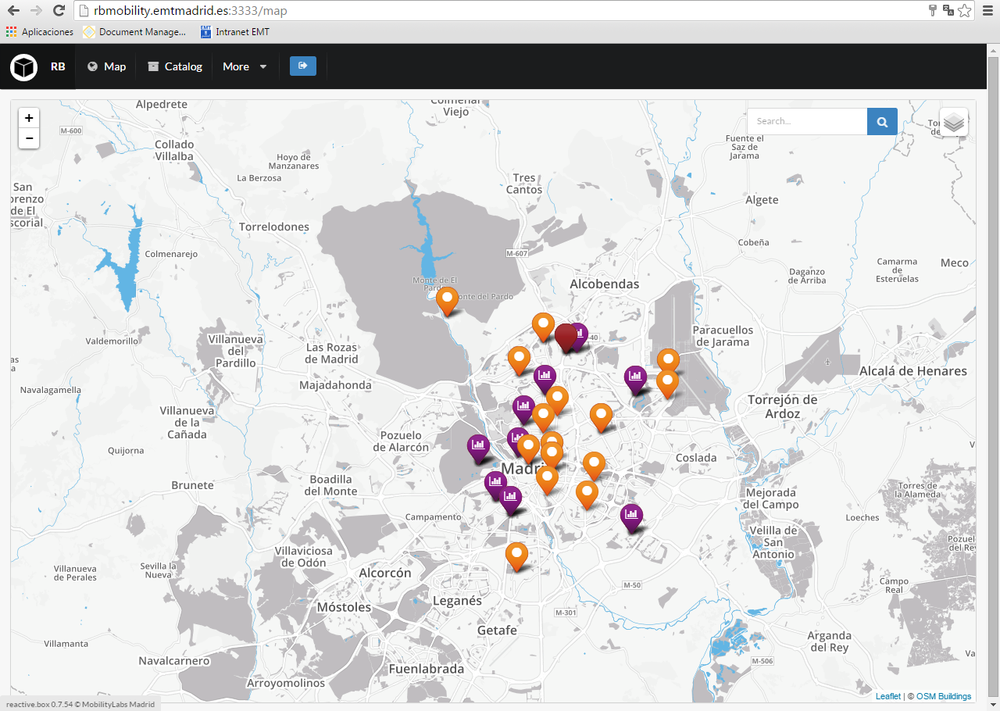
…Madrid open platform for transport (mobility) data
In real time
http://rbmobility.emtmadrid.es:3333/
Notes:
Labmadrid
labmadrid

Slide 12
Thank you very much!
http://showroom.emtmadrid.es
http://opendata.emtmadrid.es
sergio.fernandez@emtmadrid.es
@SergioFBalaguer

