Slide 1
COSMOS Cultivate Resilient Smart Objects for Sustainable City Applications
Security, Privacy and Trust & Reputation within the IoT
Leonard Pitu (Siemens), Orfefs Voutyras (ICCS/NTUA)

Slide 2
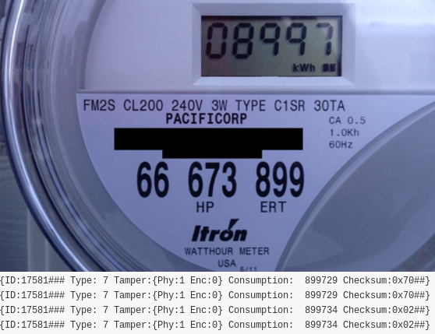
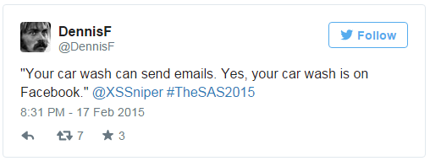
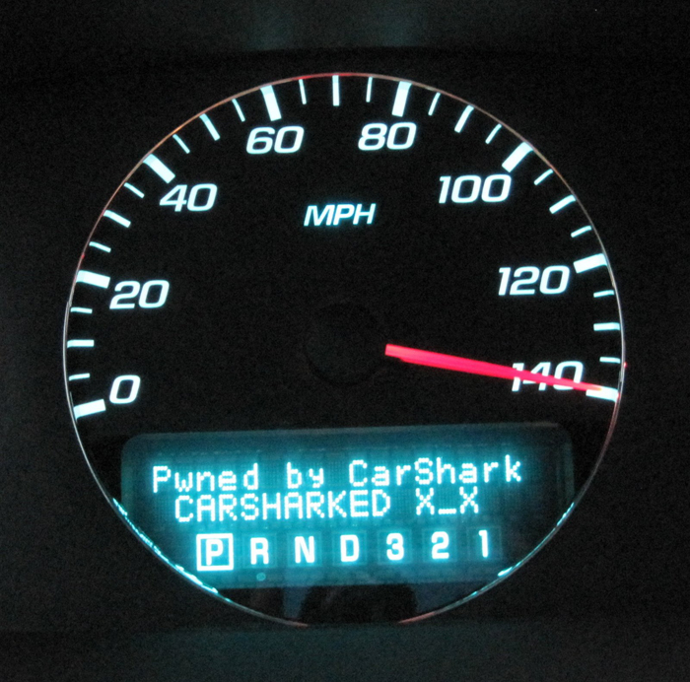
Why security?
2008: Schoolboy hacks into city's tram system
2010: Car dashboard hack via CAN Bus
2011: Insulin pump hacking demo at conference
2014: 20$ smart meter hack published
2015: a carwash was hacked ☺
Kaspersky declared 2015 the year of
“Internet of Crappy Things”

Slide 3
COSMOS vision
Privacy
Applications
Firmware
Hardware
Software
QoS
Cloud security & Privacy
Local Security & Privacy
Hardware
Trust & Reputation

Slide 4
Security primitives
Focusing on:
Encryption
Key agreement
True Random Number Generation
Supported standards:
AES128 – FIPS197 compliant
ECDH – NIST SP 800 56A
TRNG – NIST SP 800 22

Slide 5
1. Hardware Security
Encryption
Key Exchange

Slide 6
Security enables the user

Slide 7
2. Privelets
Applies on two different models of communication
Push is applied when a Thing consistently feeds its data towards the communication services of COSMOS (such as the Message Bus) or towards the ingestion in the Cloud storage at the COSMOS platform side
Pull is applied through the IoT Service concept, that enables an entity to query a Thing for getting a specific data field at an arbitrary time point
Implemented as a Service
Lightweight implementation to be able to run inside the Things; raspberry pi
Acts as a privacy filter
Enables the end-user to define which data he can share
Private data are entirely cut-off
Public data are available “as they are”

Slide 8
Fuzzification
Data can also be tagged as fuzzy
In many occasions (e.g. location information) people are unwilling to share their real data but (slightly) different ones (i.e. compromise between privacy and accuracy)
Low, Medium and High Privacy correspond respectively to small, medium or large (absolute) difference between the real value and the fuzzy one
Range
The fuzzy value is randomly calculated within a range (e.g. percentage) defined from the application developer
e.g. for utm coordinates; suitable range must be selected for the fuzzy location to still belong to the same town, neighborhood etc., according to the specific application

Slide 9
3. Cloud Privacy-Storlets
Metadata
Search
Building a Privacy Preserving Data Service
Storlets move computation to the data – instead of bringing the data to the computation
A Storlet Execution Sandbox (LXC) is created on the storage nodes, next to one of the replicated objects.
Different filters for different applications and users.
Message Bus
Analysis Close
to the Data
(Storlets)
Data Mapper
DataStore (OpenStack Swift)
Notes:
OpenStack Swift – popular open source tool for object storage
Storlets extend the Swift object store
Swift middleware which triggers storlets
LXC Linux container

Slide 10
Cloud Privacy-Storlets
Retrieve picture
Check access control [YES/NO/STORLET]
[which Storlet]
Execute query
Fetch image from the storage
Blur the faces according to the privacy rights of the client [using Storlets]
Read user’s rights :
Receive Picture
Encrypt the image
Upload image
Send encrypted image and “stay alive” packet
Camera
HW Security Board
Cloud
Clients
Take Picture
Sample one image
Compress the image
Receive payload
Decrypt image
Store image
Invoke the object storage and save the image
Notes:
Passenger Photos Securely Uploaded to Cloud
Sequence Diagram
Use images from surveillance cameras as the input
Secured pictures shall reach the cloud storage (Swift) over an unsecure channel; only authorized users can view the pictures
The surveillance cameras are connected to the Hardware Security Board
Periodically, the cameras take pictures which are sent to the Hardware Security Board
The Hardware Security Board encrypts (AES128) the pictures and sends them to the Gateway
The Gateway decrypts the image and pushes it to the cloud storage (Swift)
Users are authenticated using tokens; based on their credentials they are allowed to see: Raw images; Blurred faces; No pictures at all.
Facial blurring is done by Storlets

Slide 11
Cloud Privacy-Consent Management
Principle – Data subjects have the right to be informed when their personal data are being processed.
Consent – Data may be processed only when:
the data subjects have given their consent,
they are necessary for a contract,
they are needed for compliance with a legal obligation,
they are necessary for a task carried out for public interest.
Proportionality - The data processed and the time for which it is stored should be no more than required for the stated purpose.
Notes:
Data subjects - people

Slide 12
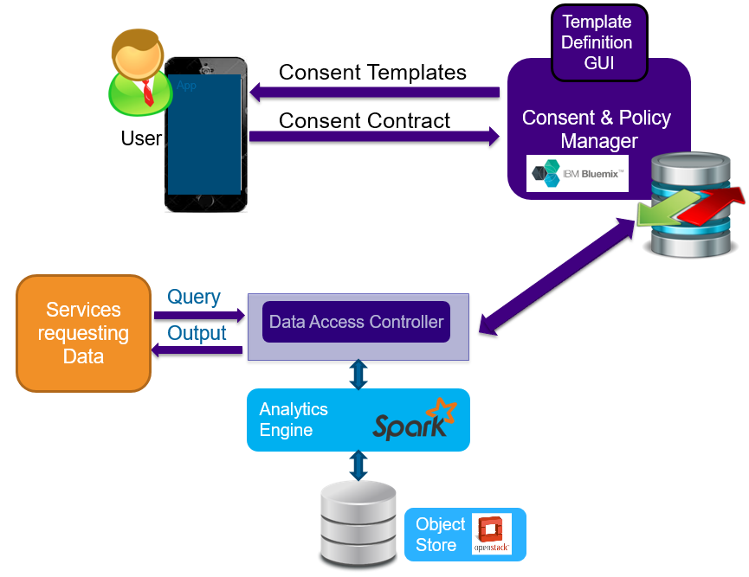
Cloud Privacy-Consent Management
The Consent GUI presents the consent template and purpose to the end-user and obtains the consent contract.
Consent Manager service on Bluemix for the collection, storage and maintenance of privacy policies and user consent.
The Data Access Controller is responsible for controlling access to the data and enforcing the data privacy policies, based on the decisions made by the Consent Manager.

Slide 13
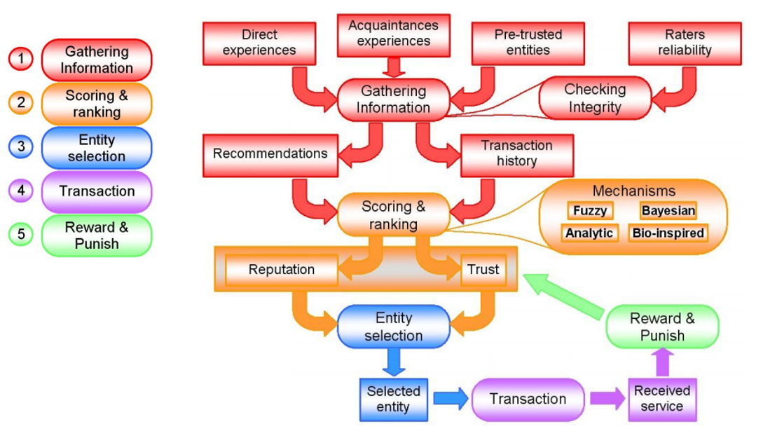
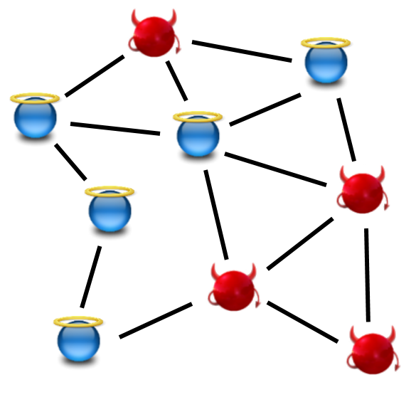
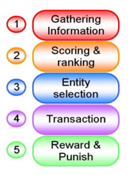
4. T&R: Making Things Social
Risk of connecting with malicious or defective Things.
QoI, QoS, Security
Trust & Reputation (T&R) models for social networks.
We created our own T&R model.
*S. Marti and H. Garcia-Molina, “Taxonomy of trust: categorizing P2P reputation systems”.
Social Exclusion
Social Integration
Social Reintegration
Notes:
Direct or indirect exchange of information or use of services/actuations.
The main problem that a Thing will face with the information acquired from its social circle is that it cannot always ensure its validity. There needs to be confidence over the information provider i.e. there needs to be Trust.
This problem can be tackled by using a Trust and Reputation (T&R) model.
Such methods have been used in many environments like P2P networks, Wireless Sensor Networks (WSN), Vehicular Ad-hoc Networks (VANETs), Identity Management Systems, Collaborative Intrusion Detection Networks (CIDN), Cloud Computing Systems, Application Stores and of course the IoT.
Collecting information about a certain participant in the community by asking other users their opinions or recommendations about that peer.
Aggregating all the received information properly and somehow computing a score for every peer in the network.
Selecting the most trustworthy or reputable entity in the community providing a certain service and effectively having an interaction with it, assessing a posteriori the satisfaction of the user with the received service.
Punishing or rewarding according to the satisfaction obtained, adjusting consequently the global trust (or reputation) deposited in the selected service provider.

Slide 14
T&R: The COSMOS T&R model
Things have Followers and Followees (non-mutual relationship) and maintain Friends Lists with logs of their last interactions.
Trust: Expectation of a satisfactory interaction based on personal experience.
Satisfaction: Essentially a subjective QoS indicator. User or automatic feedback.
Fading factor: When new interactions take place, the importance of older ones should decrease forcing Things to stay consistent.
Reputation: Expectation of a satisfactory interaction based on the experience of the social circle.
Neighborhood method: A decentralized approach avoiding bottlenecks on the system’s performance.
Sharing the Trust indexes is just another service! Evaluating the Evaluators.
Platform method: Used when the social circle cannot provide feedback for a Thing.
Notes:
Notions of social networking extended to the networks of Things, leading to a Social Internet of Things (SIoT) system by forming networks of trust.
Neighborhood method: Each Thing can use its social circle to find suitable information regarding another Thing.

Slide 15
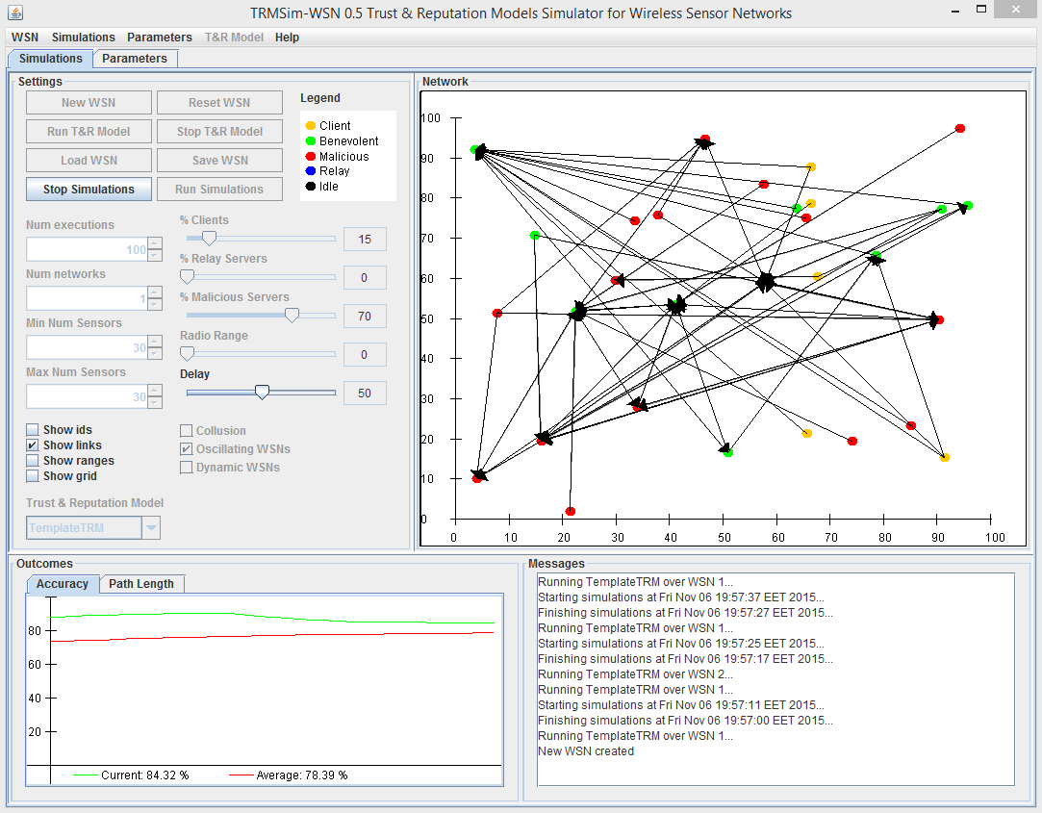
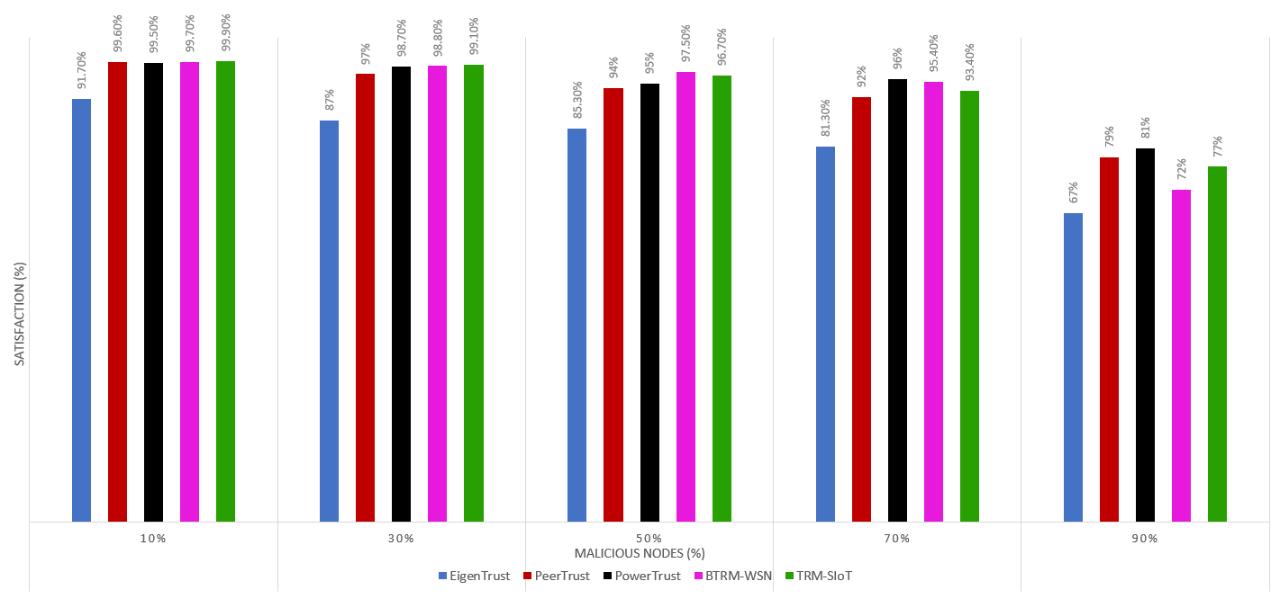
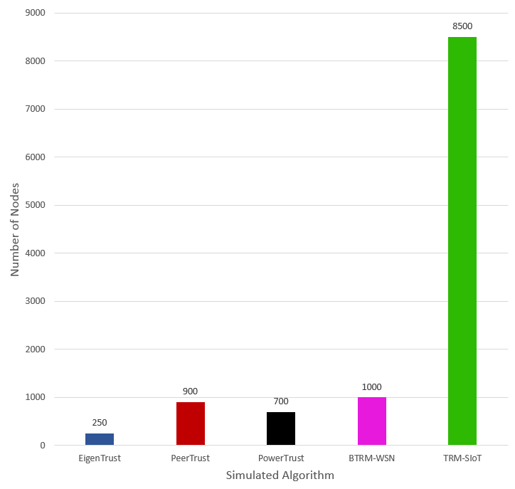
T&R: Our Results
TRMSim-WSN: a Java-based simulator for testing T&R models over various networks and comparing them with other models.
Performance Comparison for Oscillating Networks (QoI).
Scalability comparison with other T&R models.
Neither the Things nor the platform need to have a complete view of the several interactions within the system.
A T&R model suitable for the IoT.
Notes:
The results showed that the computation time of the nodes remains constant while the computation time of the Platform was linear to the size of its log file. Hence, the bottleneck of the system is on the side of the Platform which has to be a high performance server that could be upgraded or have multiple instances if needed.
TRM-SIoT provides similar satisfaction performance with other models, but there is a great difference in its design.

Slide 16
Thank you!
Leonard Pitu (Siemens)
Orfefs Voutyras (ICCS/NTUA)
www.iot-cosmos.eu
The research leading to these results has received funding from the EC Seventh Framework Programme FP7/2007-2011 under Grant Agreement n° 609043

